Slide 1

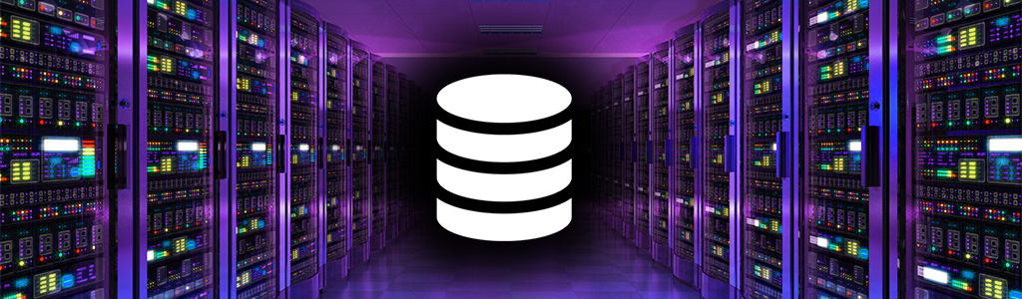
NeoDatis & neo4j
Presented By
Nixan Parmar(31)
Tejasv Modi (27)
Smit Joshi (18)
NeoDatis : An object oriented database
neo4j : a Powerful Graph Database

Slide 2
Topics Covered
NeoDatis – Nixan Parmar
What is NeoDatis ?
Features – NeoDatis
Benefits –NeoDatis
Steps To Use NeoDatis In Your Project & Simple Example
Neo4j –Tejasv Modi
What is Graph Database ? , Why To Use It ?
What is neo4j ?
Overview of Ecosystem & Features of neo4j.
Products of neo4j.
Organizations Which use neo4j.
Practical Demo –Smit Joshi
How to Create, Update , Delete Nodes & Relationships

Slide 3
NeoDatis
NeoDatis ODB is an object-oriented database for Java, .NET, Groovy, Scala, and Google Android.
It is a native and transparent persistence layer that allows you to store and retrieve objects without any mapping or conversion.
NeoDatis is a light-weight and easy to use database that is well suited for small and medium size applications.

Slide 4

Features of NeoDatis ODB
Native and transparent persistence.
Simple and easy to use
Powerful Query Language
High Performance
Scalable
Open source

Slide 5
Benefits of using NeoDatis ODB
Increased productivity.
Improved performance.
Reduced complexity.
Increased scalability.
Reduced costs.

Slide 6
Steps to use NeoDatis in your Project
Import the NeoDatis ODB library.
Create a database instance.
Store objects in the database.
Retrieve objects from the database.
Close the database instance.
NeoDatis.open()
ODB.store()
ODB.query()
ODB.close()

Slide 7
Example store and retrieve a simple object : NeoDatis
// Import the NeoDatis ODB library.
import org.neodatis.odb.ODB;
import org.neodatis.odb.ODBFactory;
// Create a database instance.
ODB odb = ODBFactory.open("mydatabase.odb");
// Create an object to store.
Person person = new Person("John Doe");
// Store the object in the database.
odb.store(person);
// Retrieve the object from the database.
Person retrievedPerson = (Person) odb.query(Person.class).uniqueResult();
// Close the database instance.
odb.close();

Slide 8
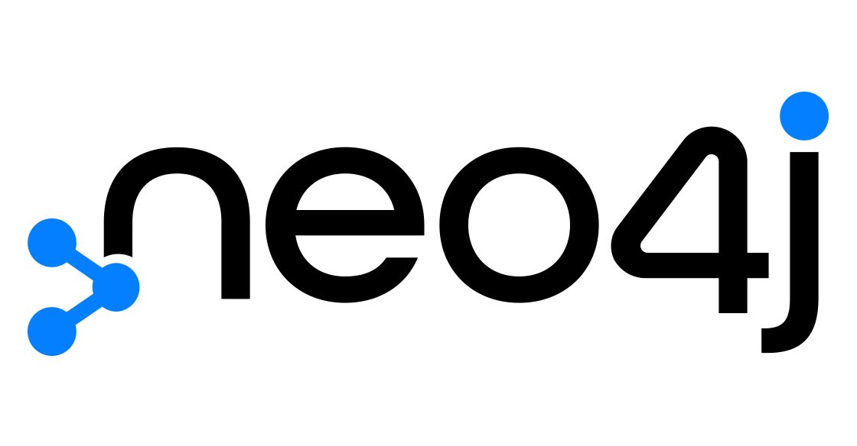

Slide 9
What is a graph database?
A graph database is a type of database that stores data as nodes and relationships
The nodes represent entities, such as people, products, or events
The relationships represent the connections between entities, such as friendships, purchases, or events

Slide 10
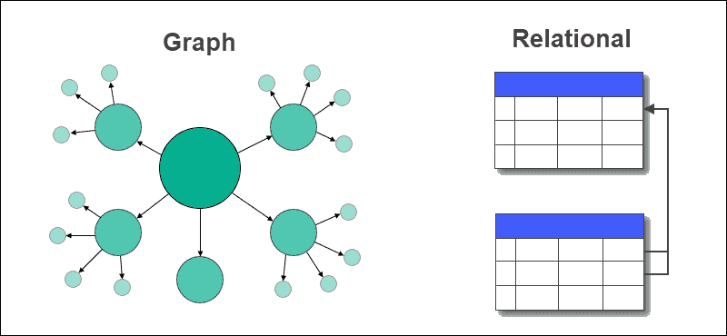
Why use a graph database?
Graph databases are well-suited for storing and querying data with complex relationships
They are also efficient for tasks such as pathfinding, social network analysis, and fraud detection

Slide 11
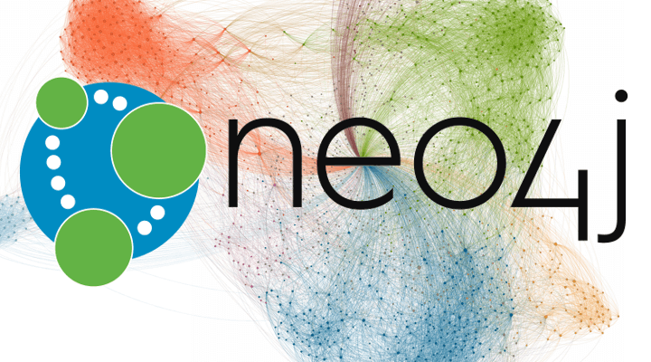
What is neo4j ?
Neo4j is a graph database management system developed by Neo4j, Inc.
Neo4j is used by a wide range of organizations, including financial services, retail, telecommunications, manufacturing, government, healthcare, energy, media and entertainment, and logistics and transportation.

Slide 12
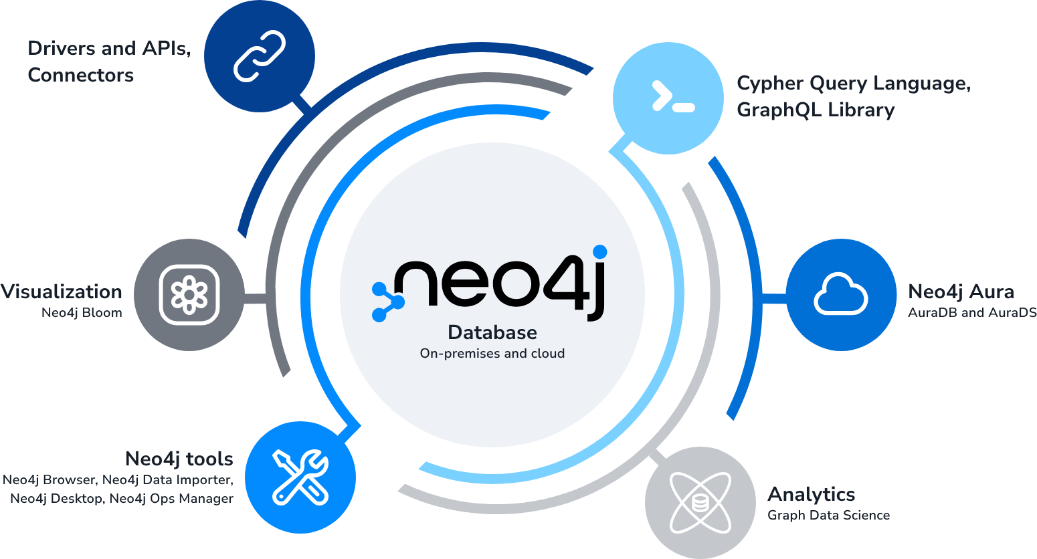
OVERVIEW of Neo4j ECOSYSTEM

Slide 13
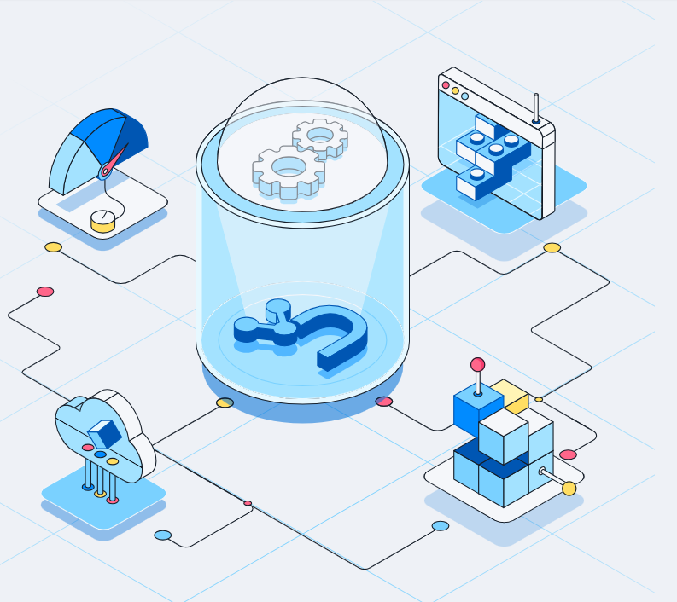
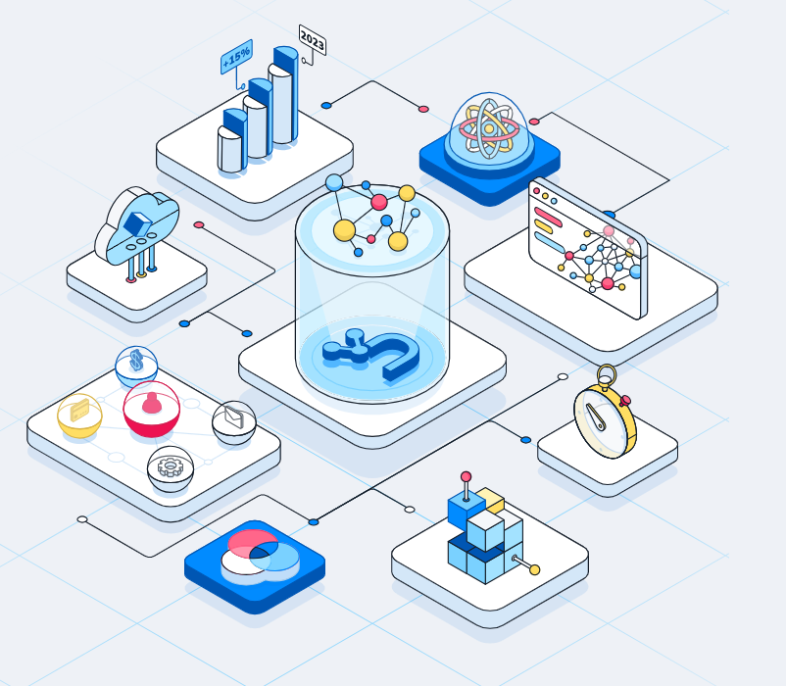
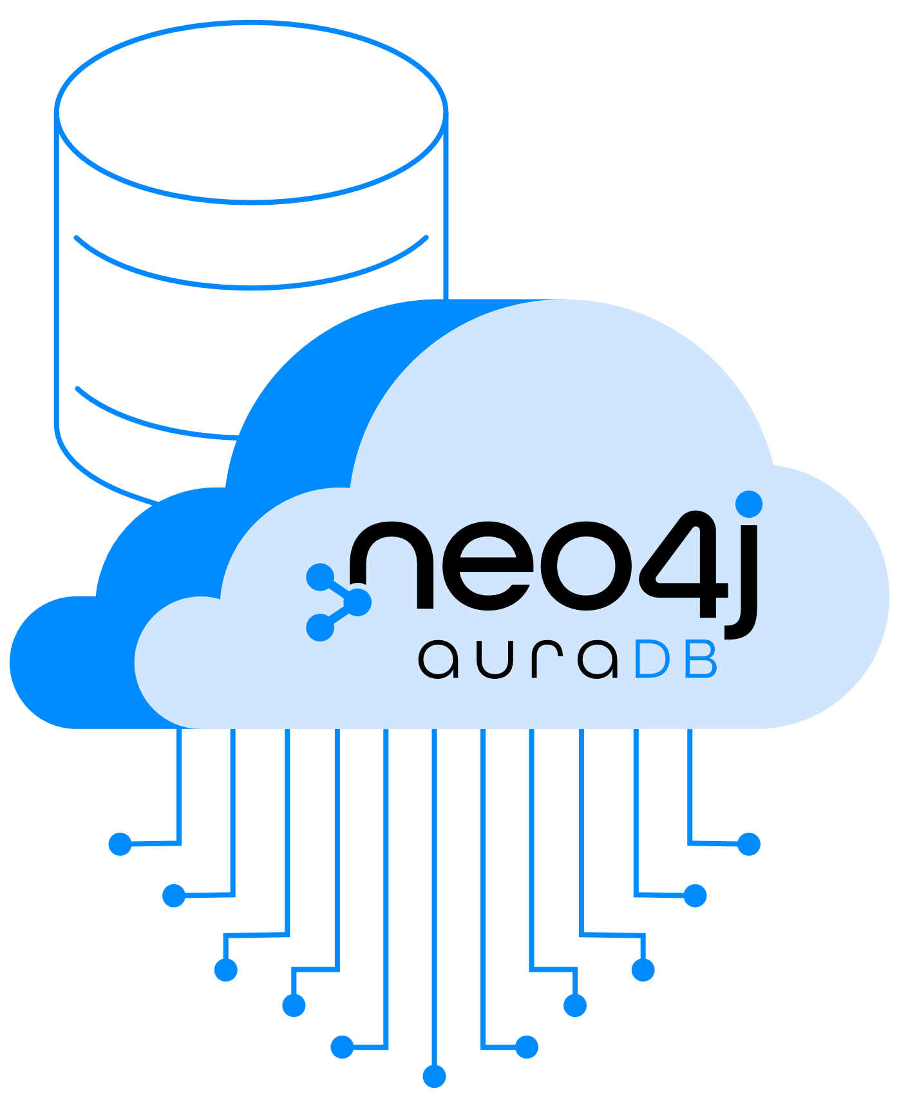
neo4j Products
Neo4j Graph Database
Neo4j Graph Data Science
neo4j auraDB

Slide 14





Organizations Which Use neo4j

Slide 15
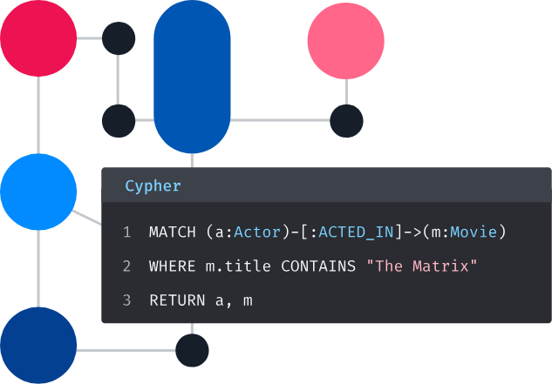
Neo4j Cypher Query Language
Cypher is a declarative graph query language that is used by developers worldwide. Created by Neo4j, Cypher provides expressive and efficient queries for property graphs.

Slide 16
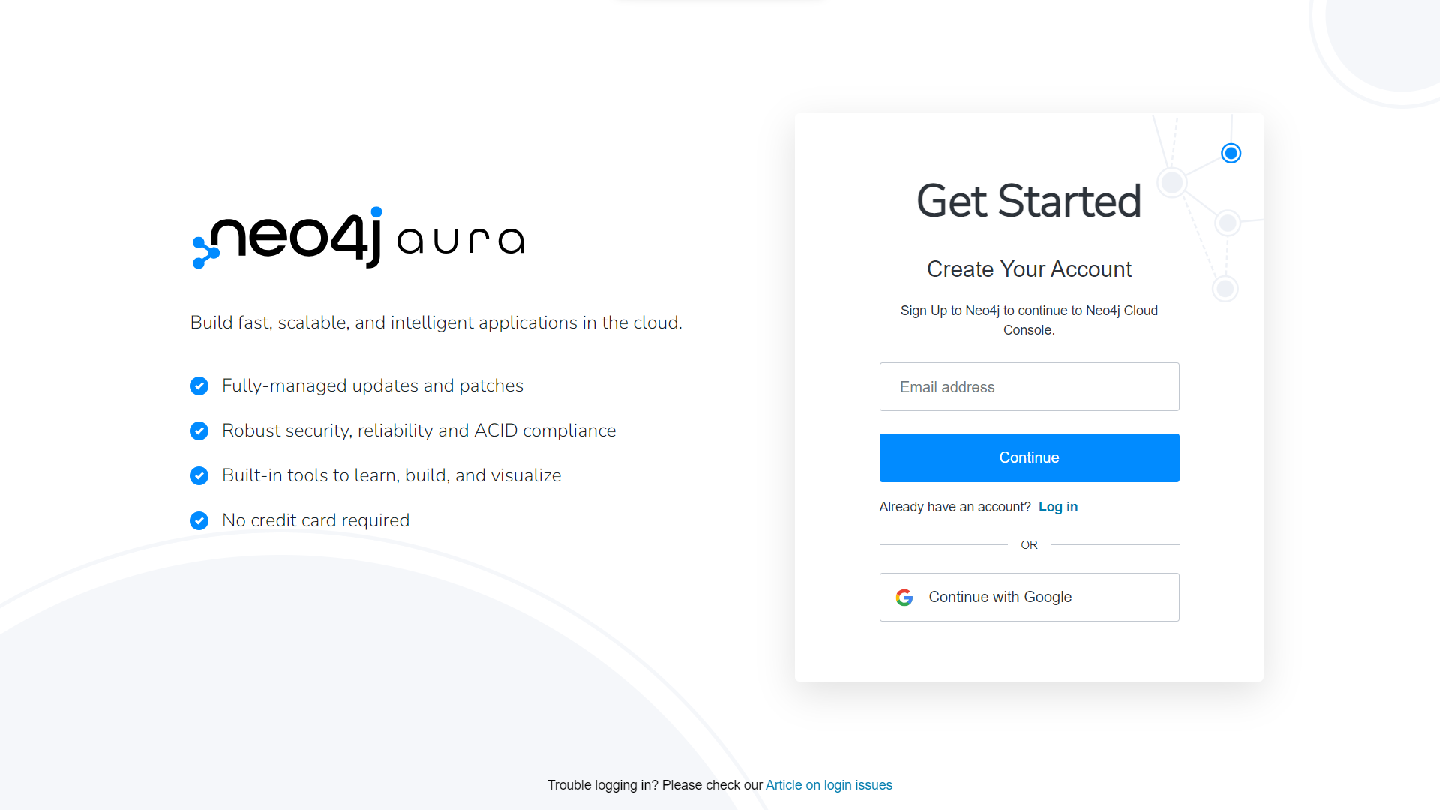

Slide 17
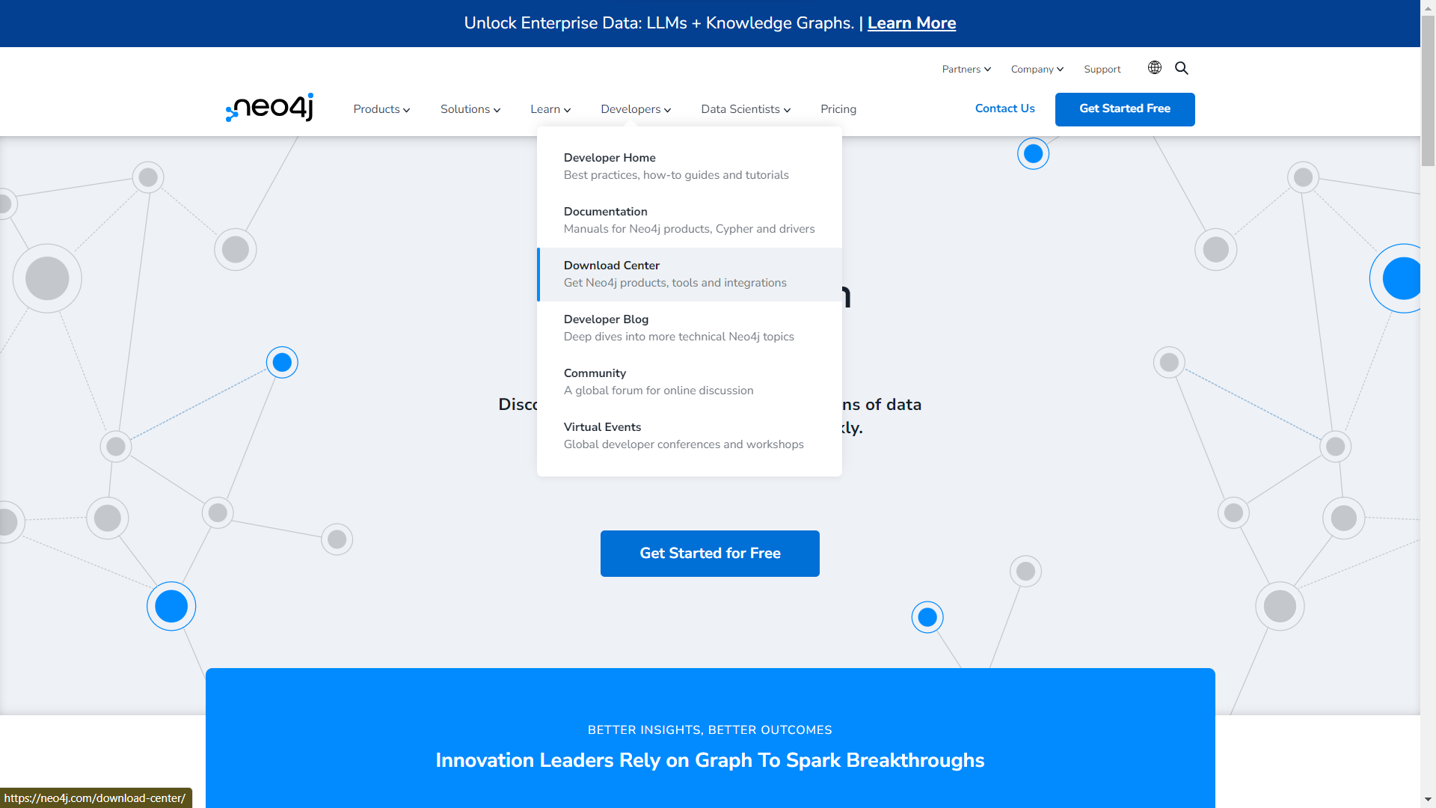

Slide 18
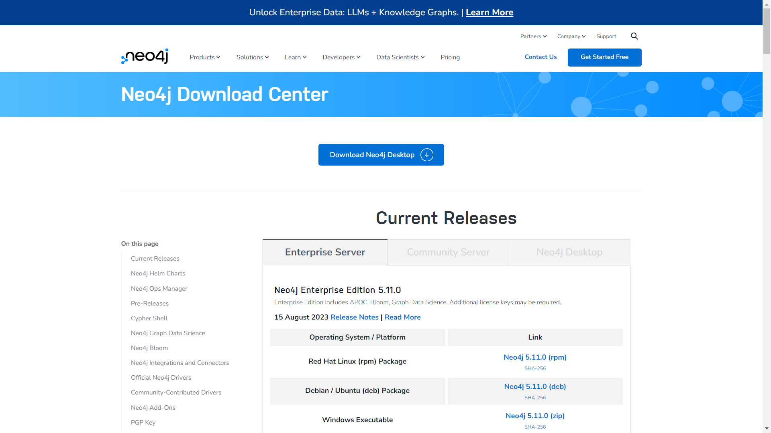

Slide 19
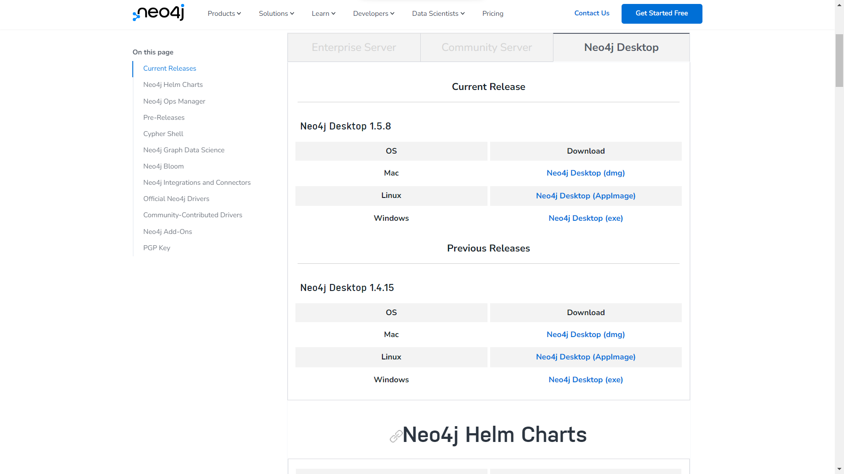

Slide 20
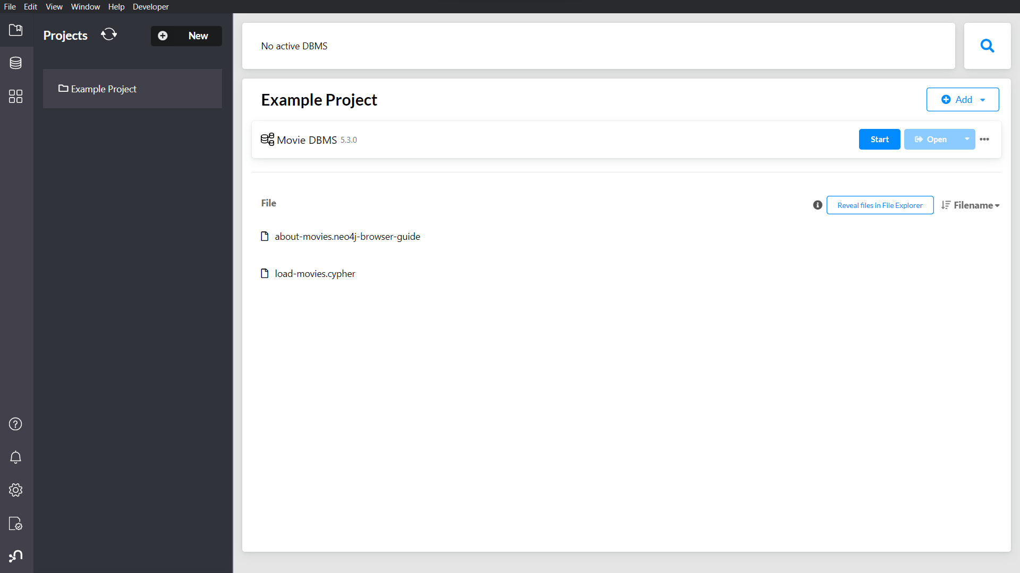

Slide 21
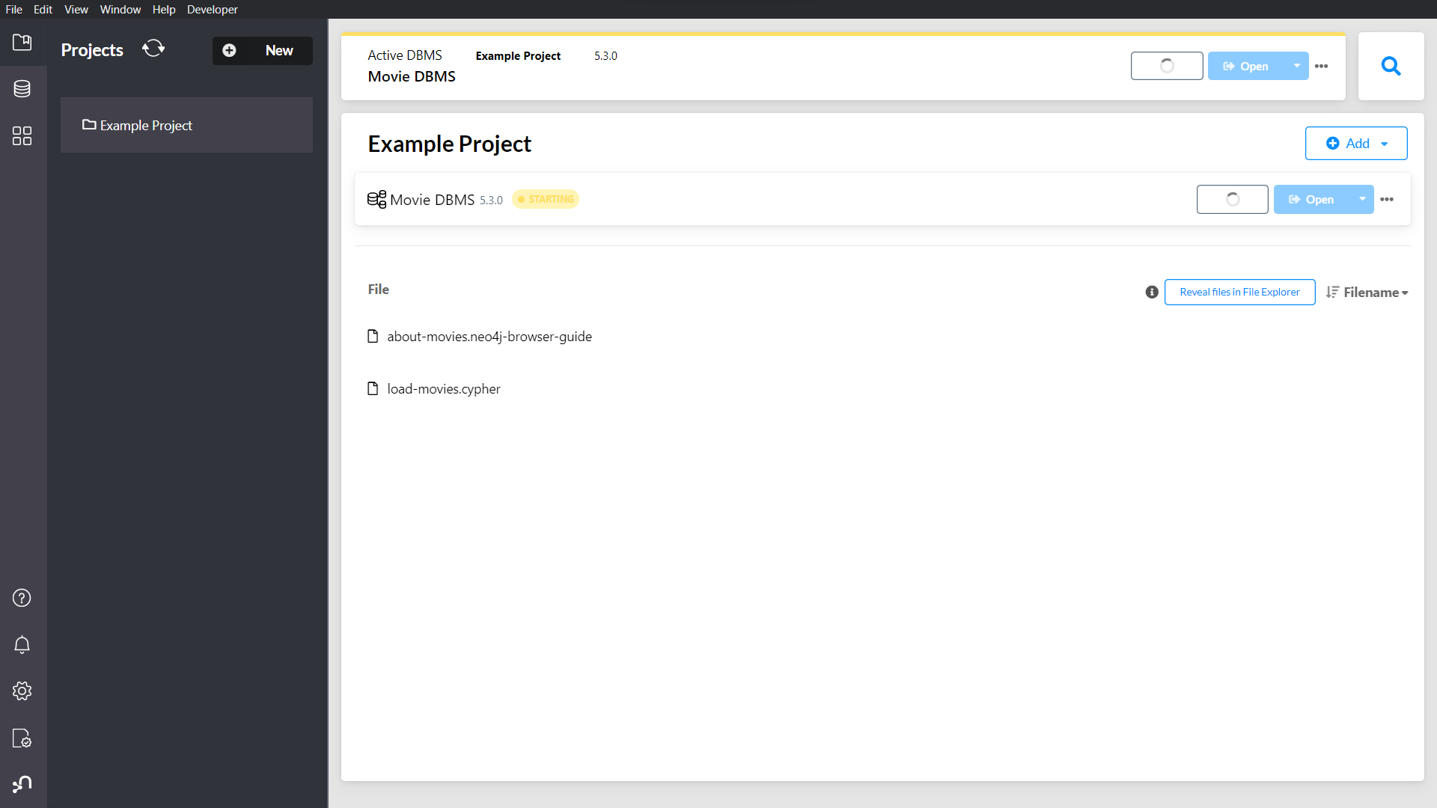

Slide 22
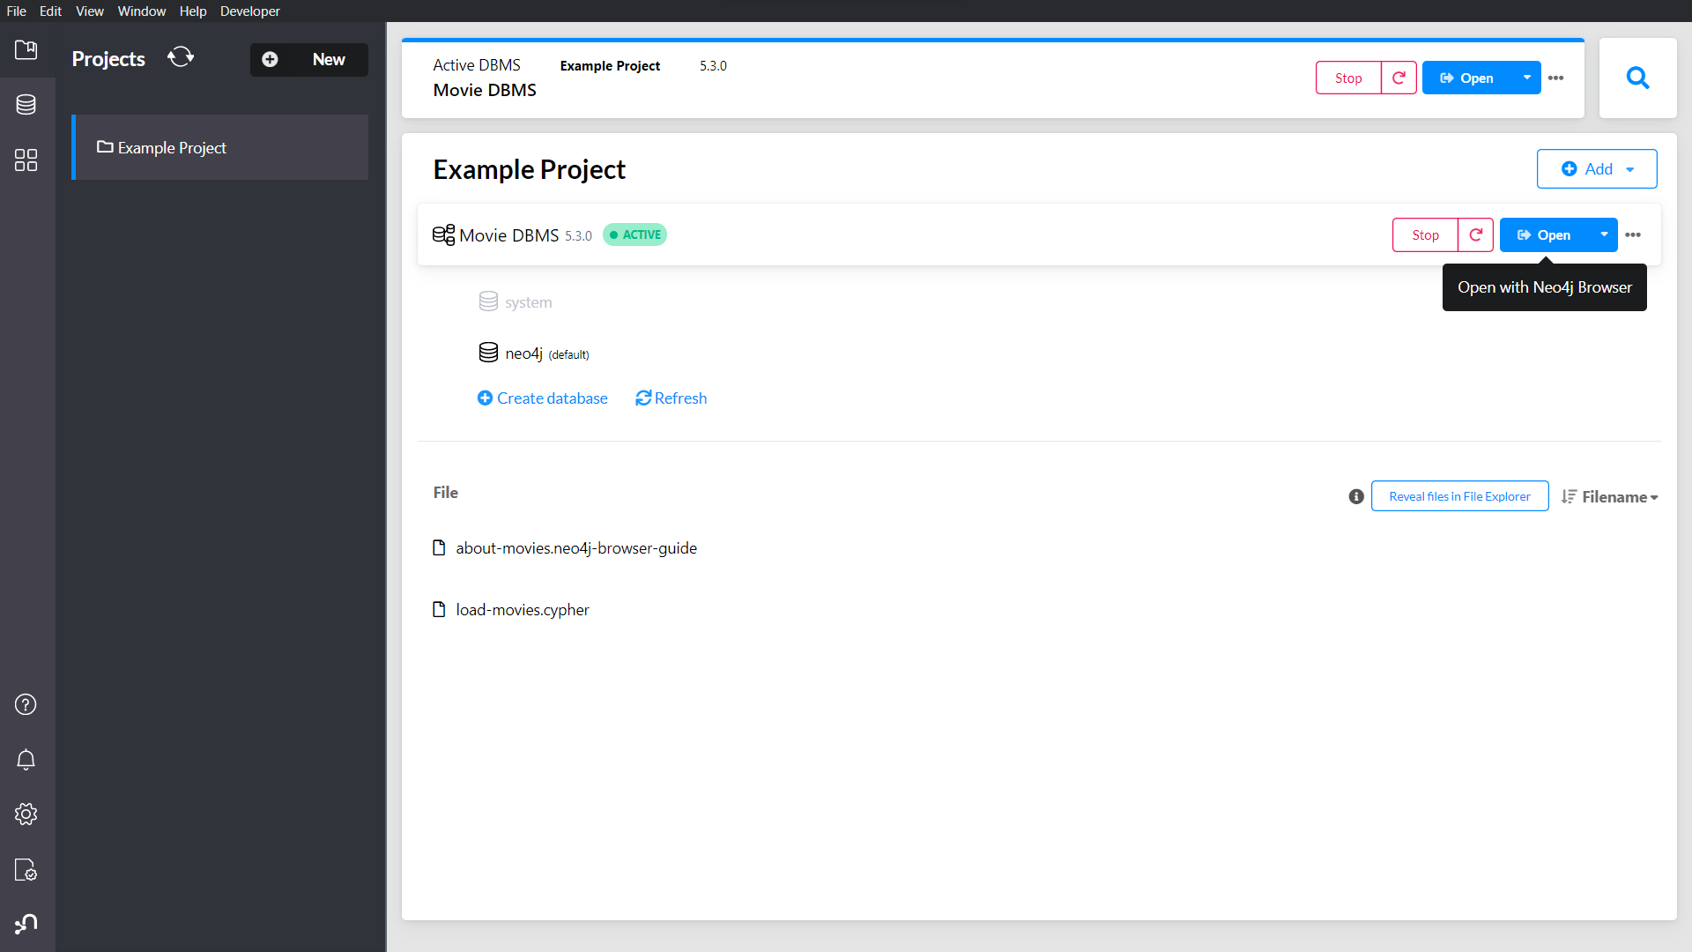

Slide 23
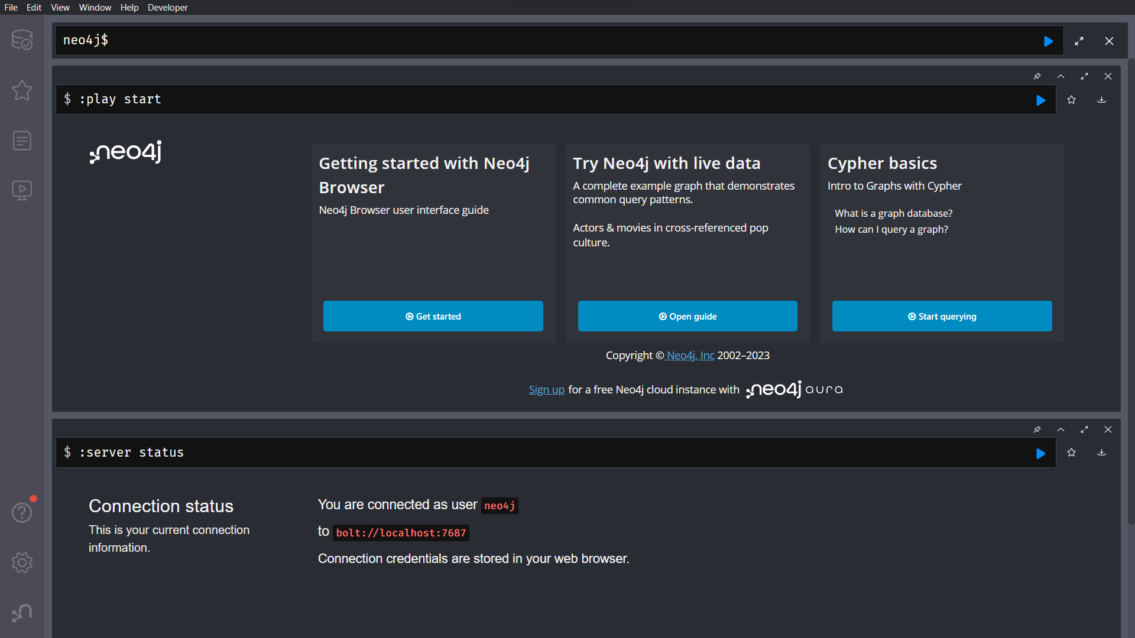

Slide 24
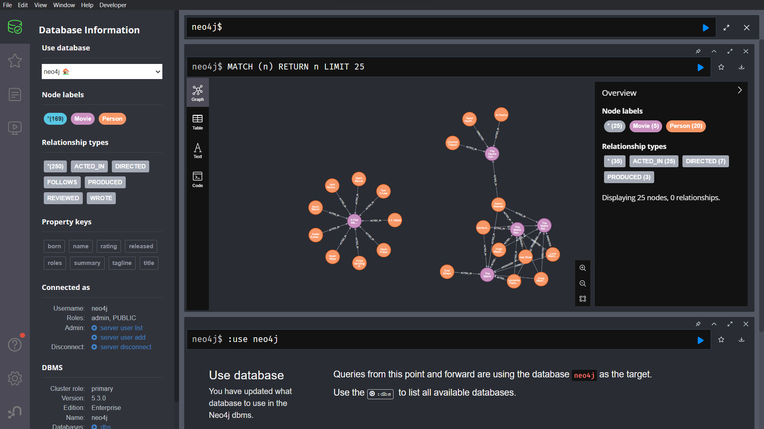

Slide 25
Thank You
Presented By
Nixan Parmar (31)
Tejasv Modi (27)
Smit Joshi (18)

